Slide 1
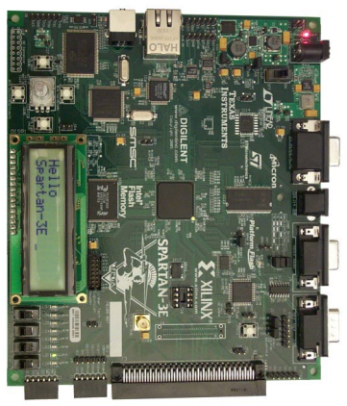
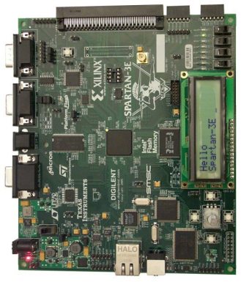
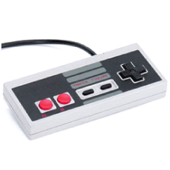
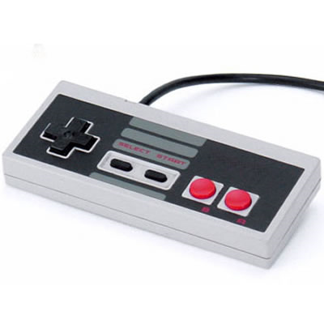
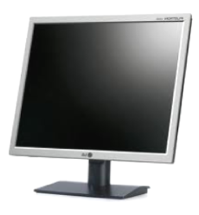
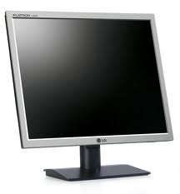
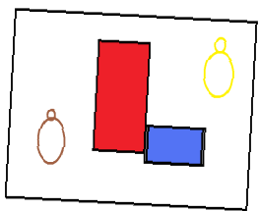
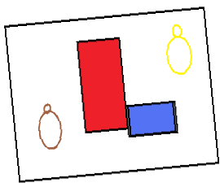
Serial Link Game
Team 1
Levi Balling, Robert Christensen, James Lewis
RS232
9
Team 1
CS 3710

Slide 2
Game Description
Two players on two machines connected with a serial link
Players explore a maze and try to reach their goal first
The view is overhead and the map will be larger than the screen and scroll
There will be interactive objects in the map
  Blocks that can be pushed around to block the way of the other player
  Items that can be picked up and used as traps for the other player
The view for each player will be centered on their character, and will only see the other player when nearby.
Team 1
0/12
CS 3710

Slide 3
Completed So Far
ALU
Register File
Memory / Memory Controller
I / O (NES Controller)
1/12

Slide 4
ALU / Regfile
Instructions followed CR16 specification where possible.
16 general purpose registers in the regfile
Simplicity of design was a significant goal in the design of the ALU.
Team 1
2/12
CS 3710

Slide 5
ALU and Regfile Verification
Miter tests performed on ALU found no significant differences.
A large test fixture was coded to test boundary cases in the ALU
A module was developed and deployed on the FPGA which would fill the register files with Fib sequence.
Team 1
3/12
CS 3710

Slide 6
Memory
Core Generator was used to generate dual-port memory with 16K words.
  Memory structure can be quickly and easily modified by using Core Generator file.
Memory was tested by initializing the memory with large set of prime numbers. Using switches and push buttons on the FPGA board memory location could be viewed or modified.
Team 1
4/12
CS 3710

Slide 7
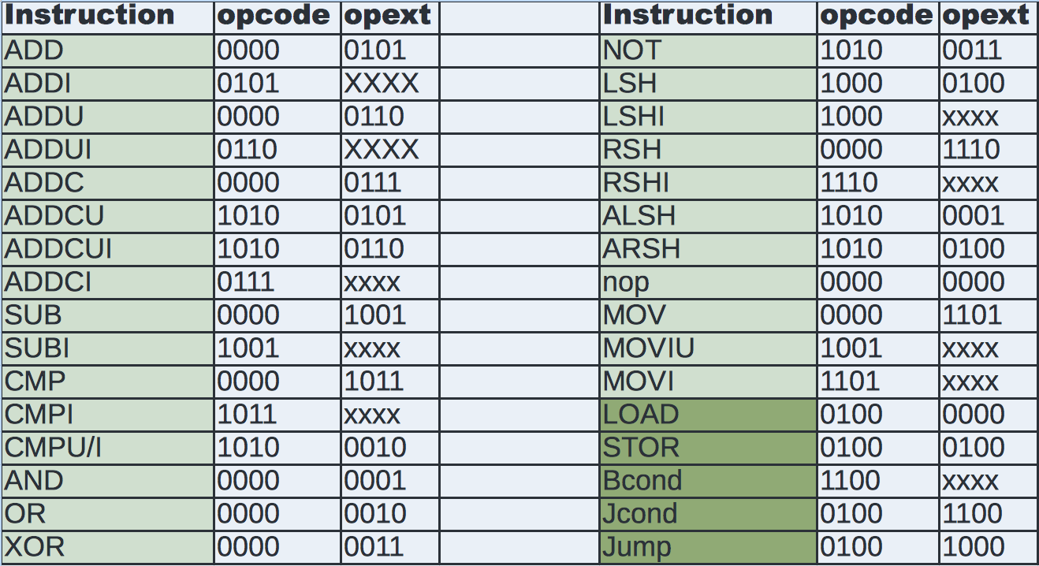
Instruction Set:
Team 1
5/12
CS 3710

Slide 8
Additions and Changes to Base Instruction Set
Changed JAL to plain Jump instruction
Added a MOVIU to move an 8 bit immediate value into the upper bits of an existing 16 bit value, to allow loading a 16 bit immediate in two steps.
Shift operations are single bit only
Need to add instructions to control RS-232 module
Team 1
6/12
CS 3710

Slide 9
CPU Design Overview
Two state controller module
  Fetch/Decode: Next instruction loaded into instruction register and set up control lines set to perform instruction
  Execute/Load/Store: Execute the instruction control lines set up control lines to fetch next instruction
Data path controlled by multiplexors
Team 1
7/12
CS 3710

Slide 10
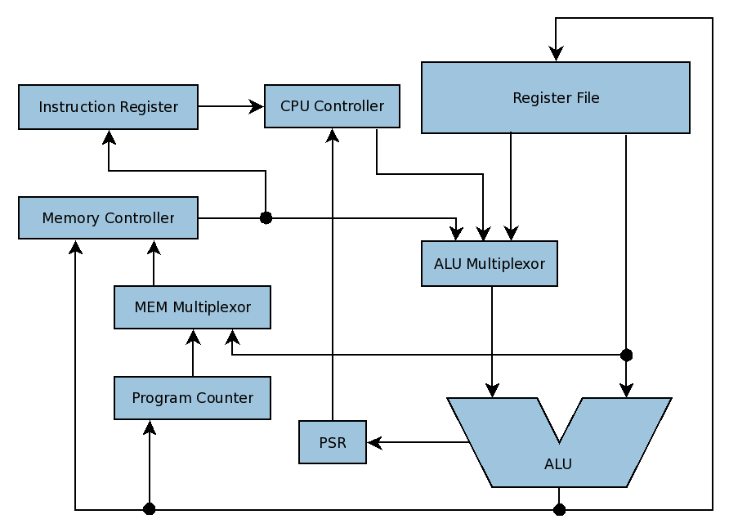
CPU Block Diagram
Team 1
8/12
CS 3710

Slide 11
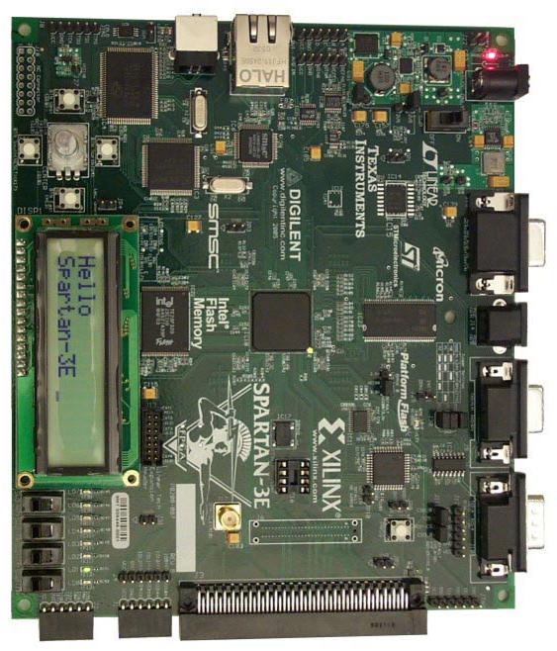
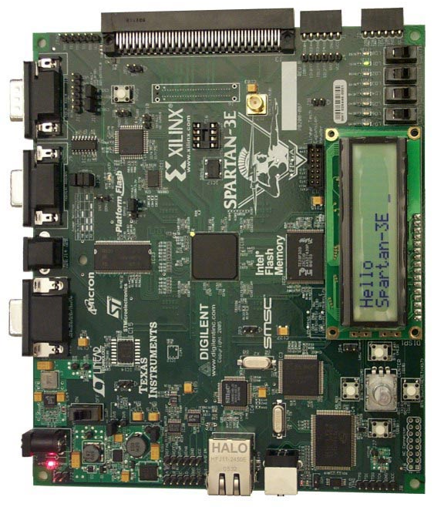
RS232 Communication
9
Team 1
9/12
CS 3710

Slide 12
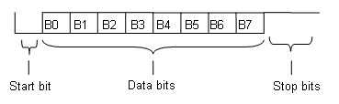
RS232 Protocol
Bit rate of 9600 bits per second
1 start bit, 1 stop bit, and 8 data bit
Built in voltage logic converter
CRC Checksum
Team 1
10/12
CS 3710

Slide 13
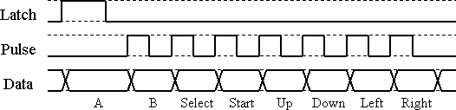
User Input
NES Controller
1 bits for each button
Can be used with 3.3v logic (tested)
Team 1
11/12
CS 3710

Slide 14
VGA Controller
640 x 480 resolution
60 Hz refresh rate
8x8 super pixels
80 x 60 super pixels
Team 1
12/12
CS 3710

Slide 15
Questions?

